Slide 1

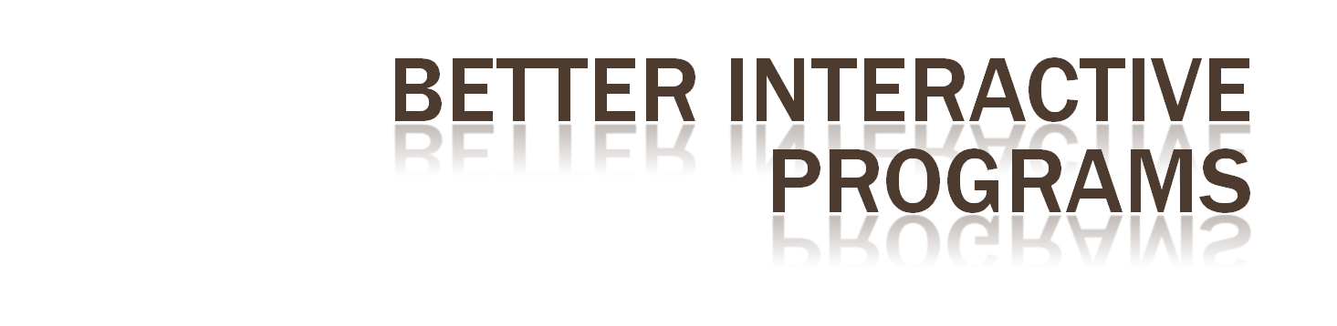

Slide 2

Learn to build more sophisticated interactive programs using
  Picking
    Select objects from the display

Slide 3

Identify a user-defined object on the display
In principle, it should be simple because the mouse gives the position and we should be able to determine to which object(s) a position corresponds
Practical difficulties
  Pipeline architecture is feed forward, hard to go from screen back to world
  Complicated by screen being 2D, world is 3D
  How close do we have to come to object to say we selected it?

Slide 4

OpenGL can render in one of three modes selected by glRenderMode(mode)
  GL_RENDER: normal rendering to the frame buffer (default)
  GL_FEEDBACK: provides list of primitives rendered but no output to the frame buffer
  GL_SELECTION: Each primitive in the view volume generates a hit record that is placed in a name stack which can be examined later

Slide 5

glSelectBuffer(): specifies name buffer
glInitNames(): initializes name buffer
glPushName(id): push id on name buffer
glPopName(): pop top of name buffer
glLoadName(id): replace top name on buffer
id is set by application program to identify objects

Slide 6

Initialize name buffer
Enter selection mode (using mouse)
Render scene with user-defined identifiers
Reenter normal render mode
  This operation returns number of hits
Examine contents of name buffer (hit records)
  Hit records include id and depth information

Slide 7

As we just described it, selection mode won’t work for picking because every primitive in the view volume will generate a hit
Change the viewing parameters so that only those primitives near the cursor are in the altered view volume
  Use gluPickMatrix (see text for details)

